Slide 1



Finite Element Analysis (FEA) Lab Project 2025
Structural Analysis of a Hexagonal Component
Muhammad Anus (ME-1865)
Section A | Semester 7th | National University of Sciences & Technology

Slide 2


Project Overview
Analysis Phases
Project Objective
The study encompasses two primary phases:
This project performs a comprehensive Finite Element Analysis (FEA) on a custom hexagonal component to evaluate its mechanical integrity under specific loading conditions.
1.
Static Structural: Steady-state response to fixed loading.
2.
Transient Structural: Time-dependent response to variable loading.

Slide 3
Material Properties
The material properties were defined using a custom configuration derived from the student's roll number (ME-1865).
Property | Value | Unit
Young's Modulus | 65,000 | MPa
Poisson's Ratio | 0.28 | -
Tensile Yield Strength | 300 | MPa
Bulk Modulus | 4.92 × 104 | MPa

Slide 4

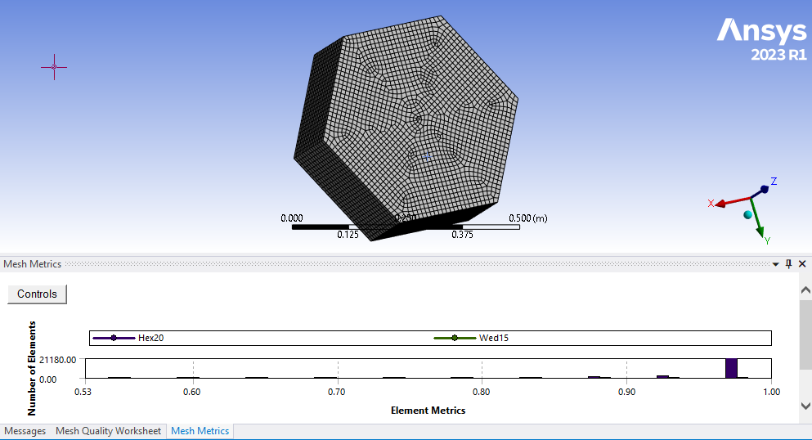
Meshing Strategy
To ensure simulation accuracy, a rigorous meshing strategy was employed:
Element Type: Utilized Hex20 (20-node brick elements), known for high-order accuracy in 3D structural problems.
Face Meshing: Explicitly applied to faces 2 through 7 to force a structured grid.
Quality Metrics: The mesh metrics confirmed excellent element quality, with values predominantly close to 1.00, ensuring solution stability.

Slide 5
Static Analysis Setup
Boundary Conditions
Solver Settings
Fixed Support: Applied to one face of the hexagonal component, constraining all degrees of freedom (DOF) to simulate a rigid mount.
Convergence: The solution was configured for up to 10 loops but achieved rapid convergence within just 3 steps.
Remote Force: A calculated force of roughly 2061 N was applied to the opposing face to induce mechanical stress.
Stability: The minimal change (2.35e-10%) between final steps indicates a highly stable numerical solution.

Slide 6
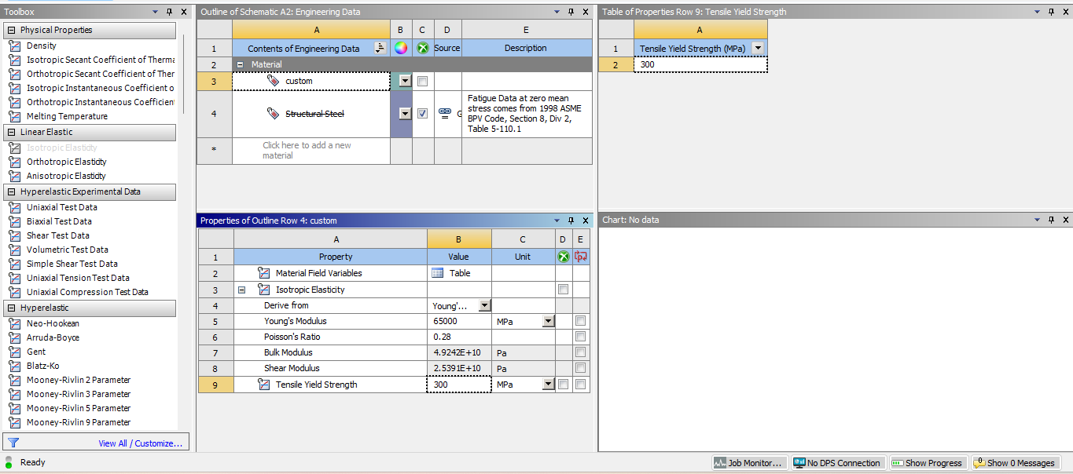
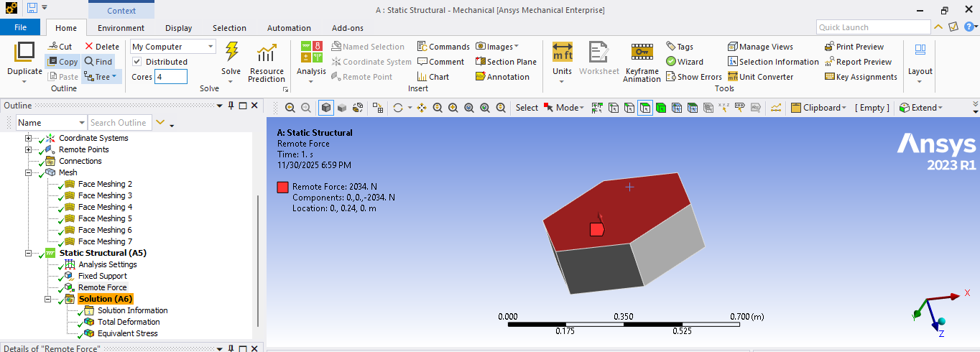
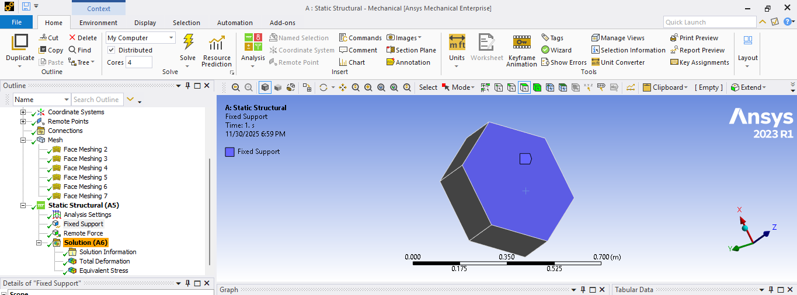
Static Analysis Setup

Slide 7
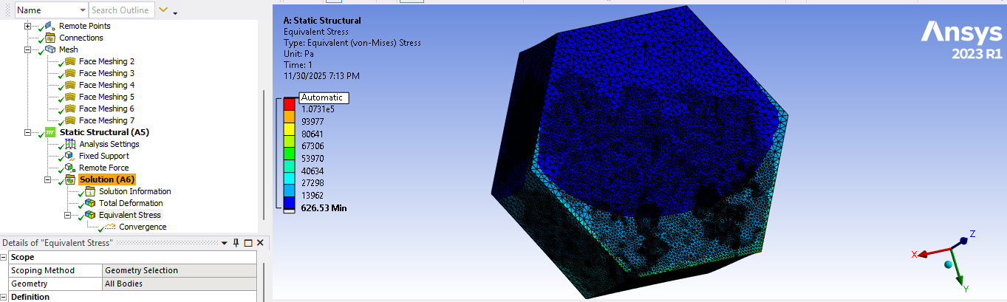
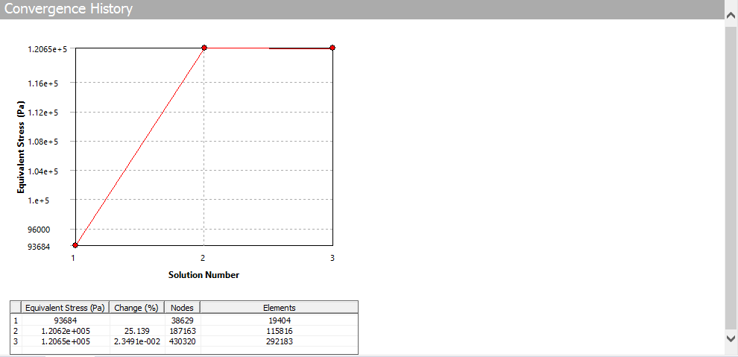
Static Results: Stress & Convergence
Equivalent (Von-Mises) Stress
The simulation yielded a maximum stress of 107,300 Pa (0.107 MPa).
Safety Conclusion: The induced stress is significantly lower than the material's Tensile Yield Strength of 300 MPa.
The component is well within the elastic limit, showing no risk of plastic deformation or failure under the applied static load.

Slide 8
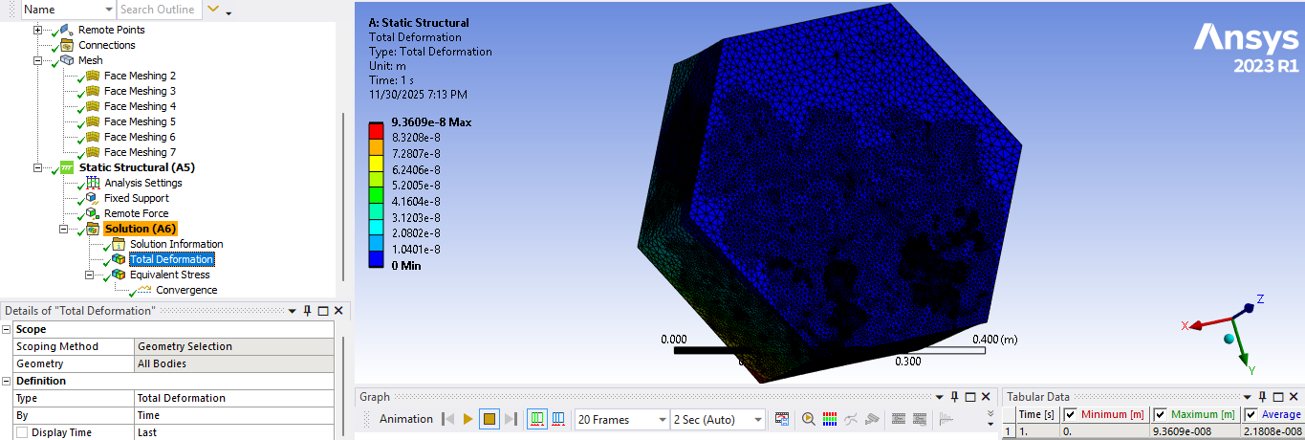
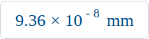
Static Results: Deformation
Minimal Displacement
The maximum total deformation observed was:
This negligible value highlights the high stiffness of the material (E = 65 GPa) and confirms the structural rigidity of the design under the prescribed loading conditions.

Slide 9
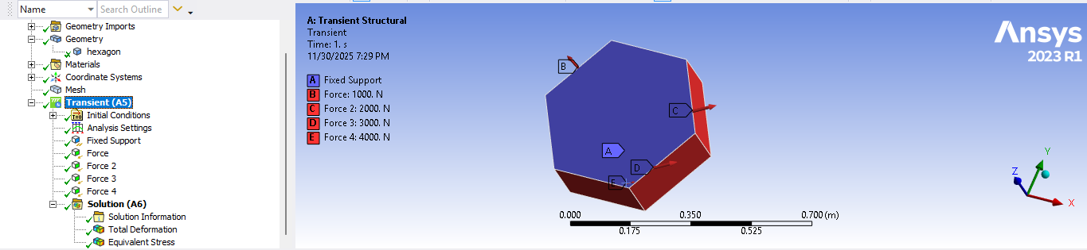
Transient Analysis Setup
Load Label | Magnitude | Application Side
Force 1 (B) | 1,000 N | Upper-left
Force 2 (C) | 2,000 N | Right Side
Force 3 (D) | 3,000 N | Lower-right
Force 4 (E) | 4,000 N | Bottom-left
.

Slide 10




Transient Results
Max Stress
Max Deformation
7.769 × 10 5 Pa
3.088 × 10 - 7 mm
(0.78 MPa)
(Transient Peak)
Increased due to multiple simultaneous loads.
Higher than static but still negligible.

Slide 11
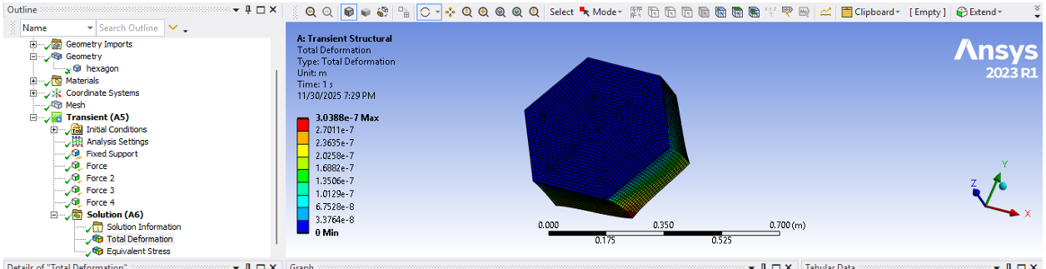
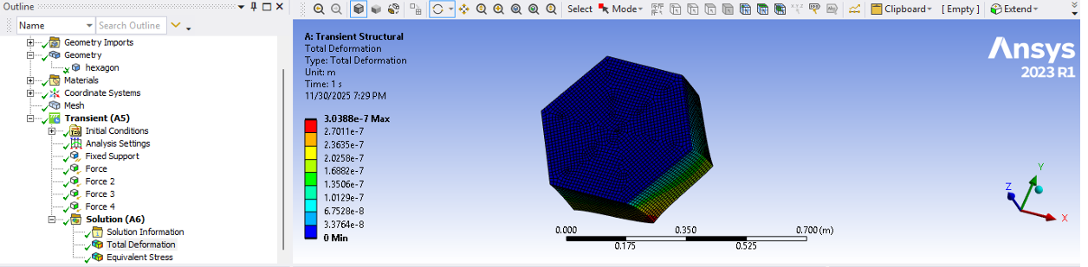
Transient Results

Slide 12
Conclusion
“
"The FEA simulation confirms the structural integrity of the hexagonal component. Under both static and transient loading conditions, the induced stresses are well below the yield strength, ensuring a high factor of safety."

Slide 13
Thankyou ☺

